Slide 1

COE 292 • Introduction to AI
Car Acceptability Classification
UCl Car Evaluation Dataset
Team S12_6
Saad Aldossary • Hassan Alfaifi • Jawad Alharbi

Slide 2

Problem Overview & Importance
Goal
Features
Predict car acceptability using KNN, SVM, and MLP models
Buying Price
Maintenance cost
vhigh/high/med/low
vhigh/high/med/low
Classes
unacc
acc
good
vgood
Number of doors
Passenger capacity
2/3/4/5more
2/4/more
Importance
• Supports real-world car purchasing decisions
• Used in recommendation systems and dealerships
Luggage boot size
Safety level
small/med/big
low/med/high
03
COE 292 | Team S12_6 | Car Evaluation Dataset

Slide 3
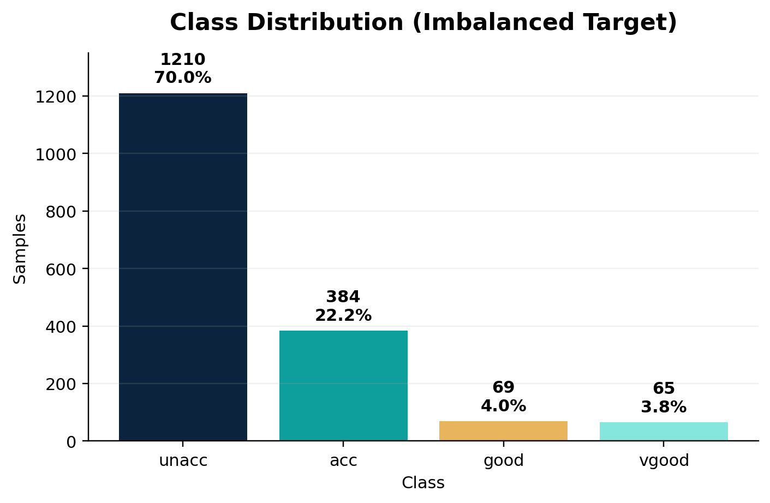
Dataset Exploration & Class Balance
Dataset Overview
1,728
6
instances
categorical features
4
0
target classes
missing values
Interpretation
Imbalanced dataset: unacc = 70% → minority classes are harder to predict
04
COE 292 | Team S12_6 | Car Evaluation Dataset

Slide 4
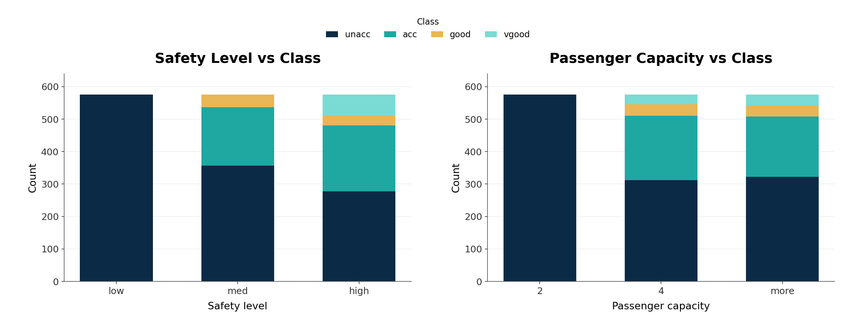
Data Visualization & Interpretation
Safety is decisive
All low-safety cars are unacceptable in the dataset.
Capacity matters
Cars with only 2 persons are all classified as unacceptable.
Minority classes
good/vgood appear under stronger safety and high passenger capacity.
05
COE 292 | Team S12_6 | Car Evaluation Dataset

Slide 5
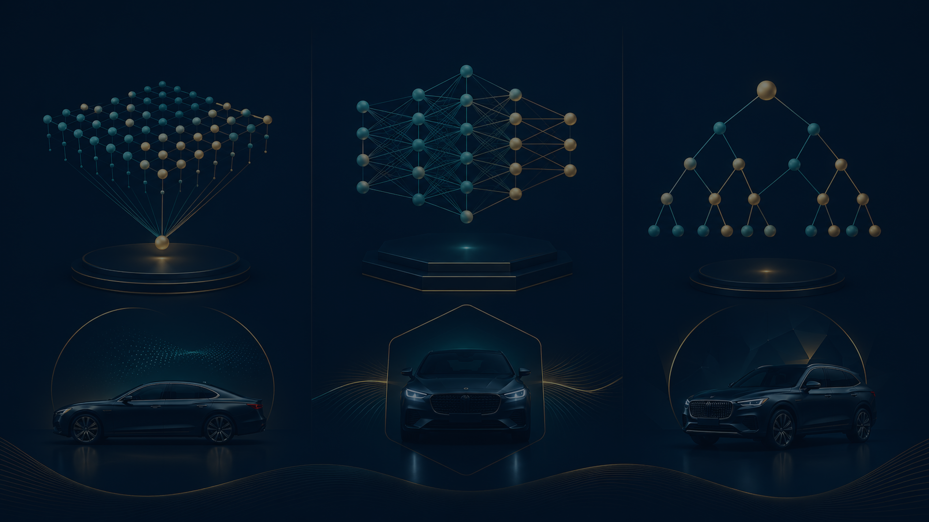
Preprocessing & Evaluation Pipeline
Raw categorical data
One-Hot Encoding
StandardScaler
Stratified 5-fold CV
Train models
Evaluate models
→
→
→
→
→
6 features
No false order
for scale-sensitive models
same class ratios
KNN • SVM • MLP
metrics + confusion matrix
Preprocessing rationale
Model rationale
• One-Hot Encoding avoids false ordering
• Scaling is applied after encoding because KNN, SVM, and MLP are scale-sensitive.
• Applied inside each fold to prevent data leakage.
KNN
distance - based baseline
SVM
tests linear vs non-linear kernels
MLP
captures nonlinear relationships
06
COE 292 | Team S12_6 | Car Evaluation Dataset

Slide 6
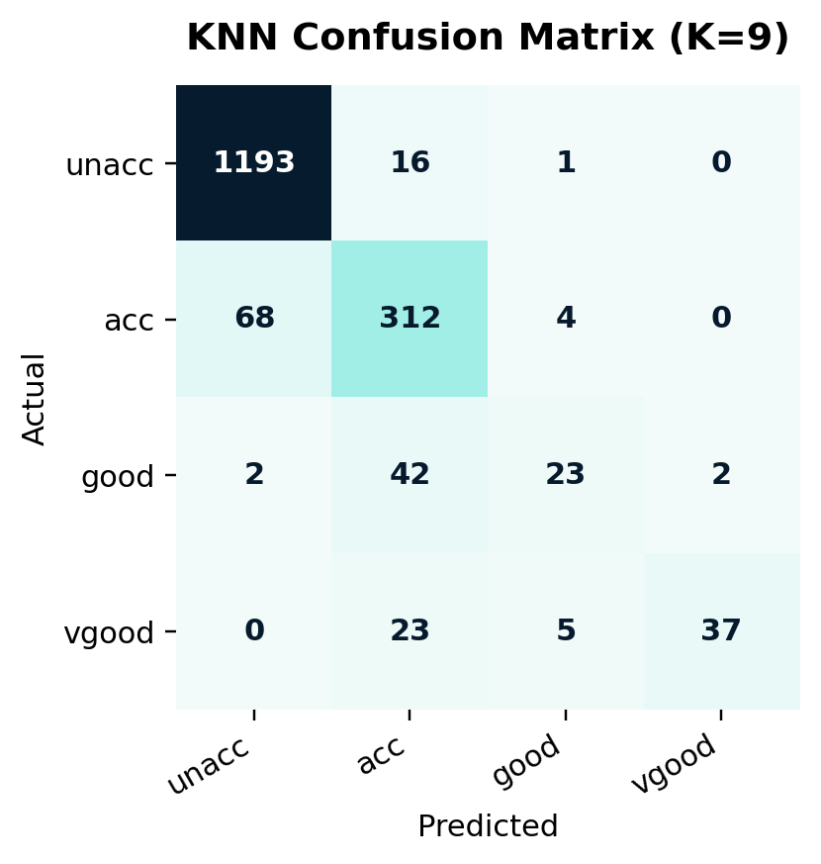
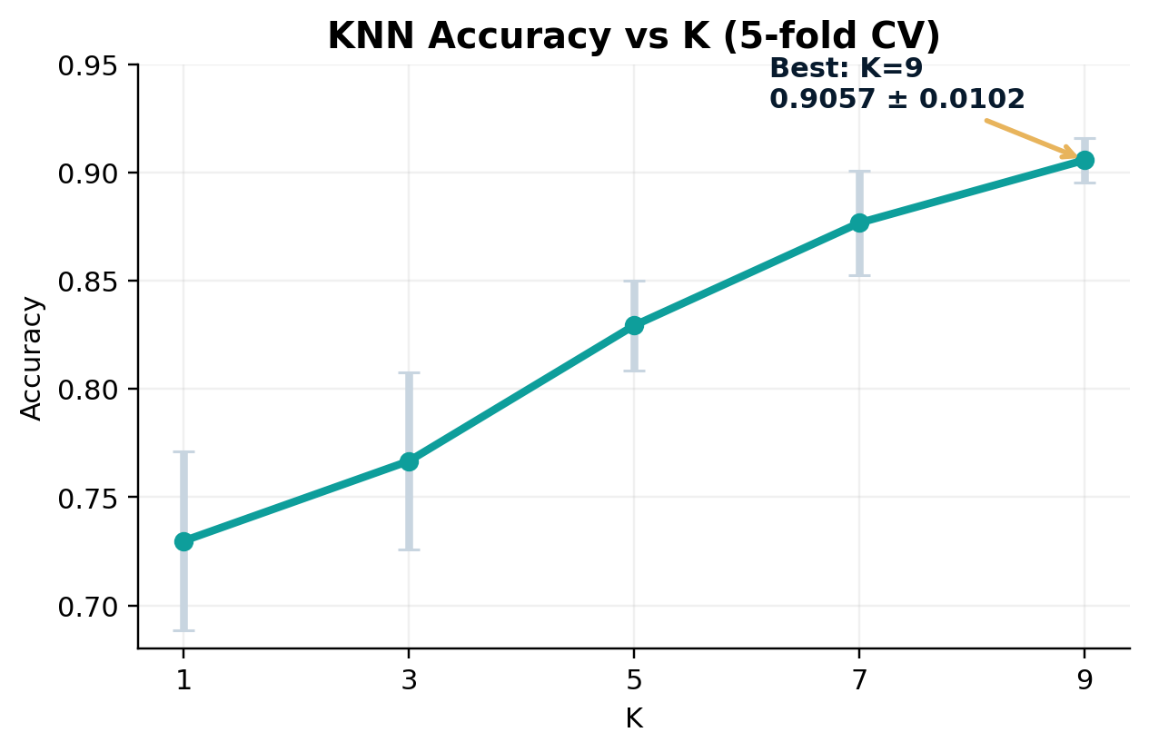
K-Nearest Neighbors (KNN) using Euclidean distance
0.9057
0.8981
0.6751
0.9493
Accuracy
F1-score
Sensitivity
Specificity
Key Insight: K=9 performs best with high accuracy, but low sensitivity shows difficulty with minority classes such as good/vgood.
07
COE 292 | Team S12_6 | Car Evaluation Dataset

Slide 7
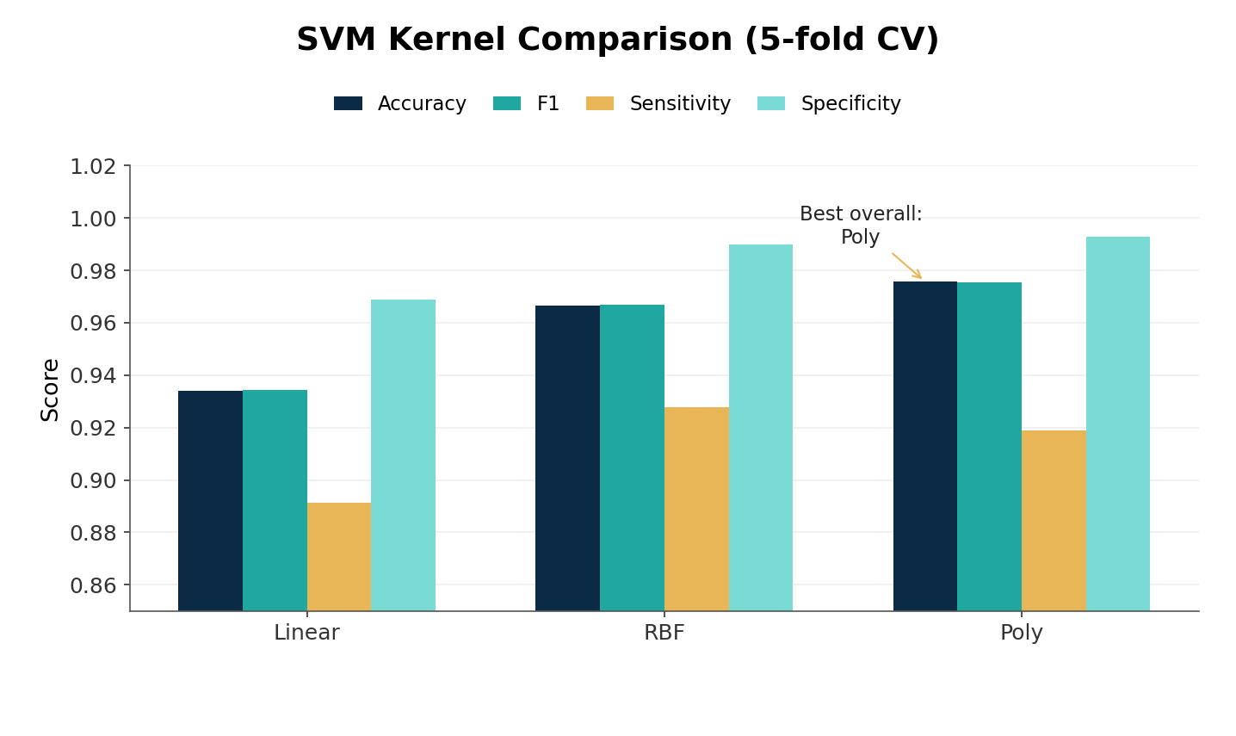
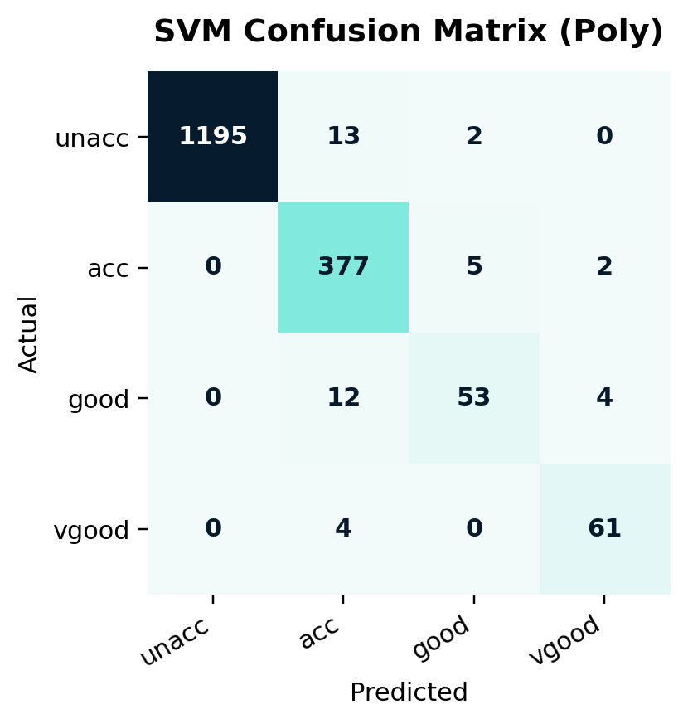
Support Vector Machine (SVM)
0.9757
0.9753
Accuracy
F1-score
0.9190
0.9927
Sensitivity
Specificity
Key Insight: Polynomial SVM achieves the best overall performance, while RBF improves sensitivity for minority classes, indicating that nonlinear kernels capture complex decision boundaries with many support vectors.
08
COE 292 | Team S12_6 | Car Evaluation Dataset

Slide 8
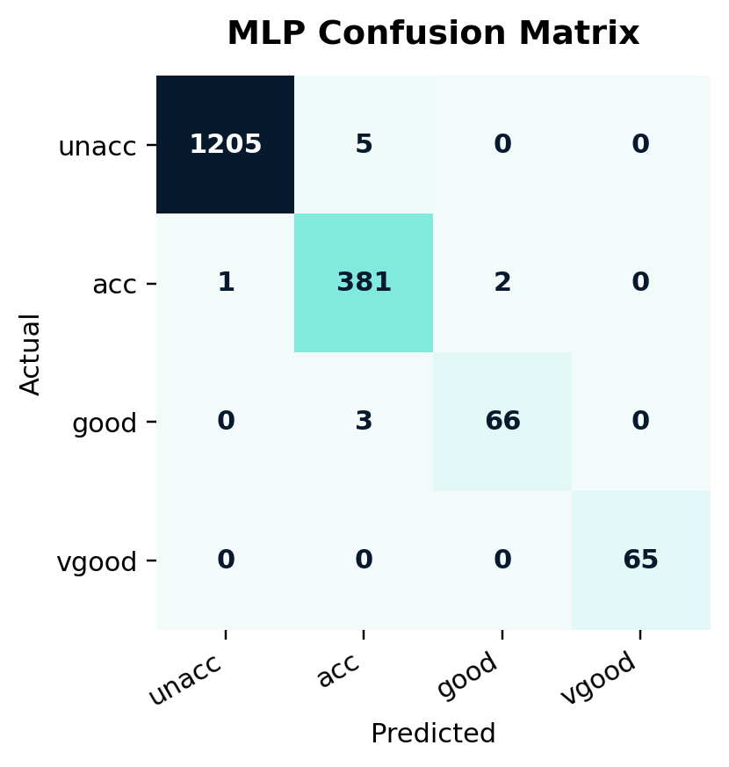
MLP Neural Network
Network architecture
0.9936
0.9936
Accuracy
F1-score
0.9855
0.9977
Sensitivity
Specificity
Input
Hidden
Output
features after One-Hot + scaling
30 neurons ReLU
4 classes SoftMax
Training settings
• Adam optimizer • learning rate = 0.01
• batch size = 200 • max iterations = 500
Key insight: A simple MLP (single hidden layer) achieves top performance with stable results, showing that deeper networks are not required for this dataset.
09
COE 292 | Team S12_6 | Car Evaluation Dataset

Slide 9
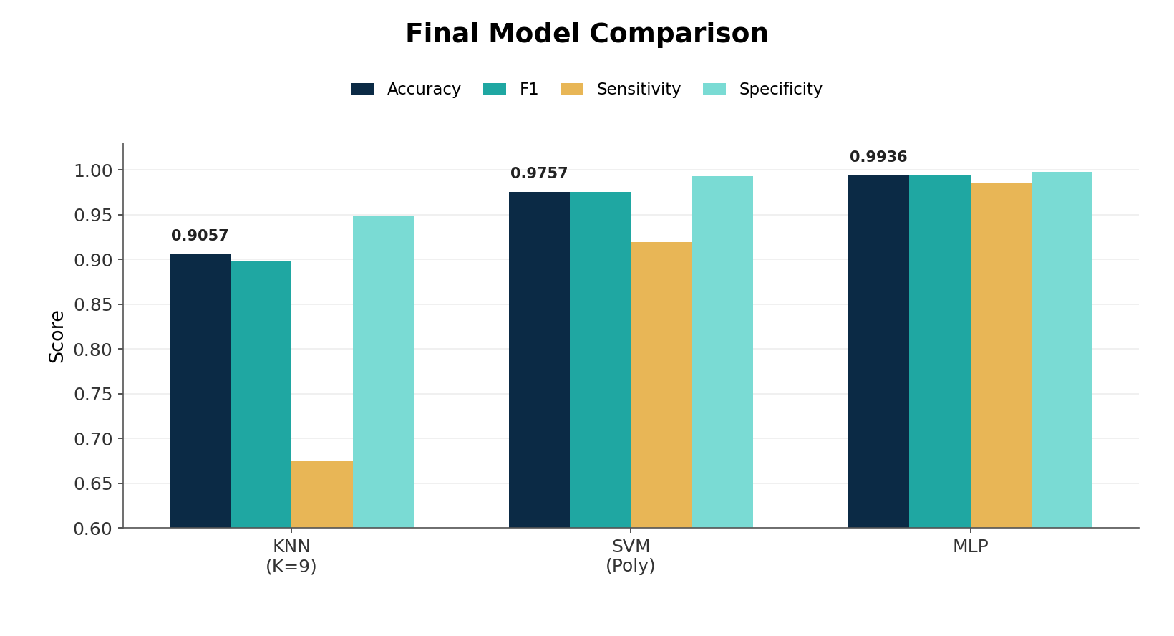
Model Comparison & Discussion
Average performance metrics
Model | Accuracy | F1 score | Sensitivity | Specificity
KNN (K=9) | 0.9057 | 0.8981 | 0.6751 | 0.9493
SVM | 0.9757 | 0.9753 | 0.9190 | 0.9927
MLP | 0.9936 | 0.9936 | 0.9855 | 0.9977
1
MLP
Best, but requires tuning
2
SVM Poly
Balanced performance
3
KNN (K=9)
Simple but weak sensitivity
Final Insight: Nonlinear models (SVM and MLP) outperform KNN, with MLP achieving the best overall performance, while KNN is the most affected by class imbalance.
10
COE 292 | Team S12_6 | Car Evaluation Dataset

Slide 10
Insights, Limitations & Conclusion
Key insights
Limitations
Conclusion
• Safety and passenger capacity strongly influence acceptability.
• Nonlinear models perform better because the dataset contains complex patterns that KNN can’t capture.
• Class imbalance affects model behavior, especially for KNN.
• High accuracy can be misleading, as it doesn’t fully capture performance on minority classes.
• The dataset is highly simplified, so results may not reflect the real-world scenarios.
• MLP and SVM improve performance but are less interpretable than KNN.
• MLP is selected as the final model due to its superior and stable performance.
• SVM (Poly) provides a reliable alternative.
• KNN remains useful as a simple baseline, but not as the final model.
Final takeaway: Use MLP for best performance but always consider class imbalance and interpretability when selecting models.
11
COE 292 | Team S12_6 | Car Evaluation Dataset

